Slide 1



Protecting Access and Empowering LGBTQ+ Health in a 'Safe State'
Alex Sheldon, MA (they/them)
Executive Director, GLMA
Sara Mar, MPH (they/them)
Advocacy & Comms Strategist, Whitman-Walker Institute
Notes:
Alex & Sara

Slide 2
  Legislative & Litigation Landscape
  Why is This Happening?
  The Impact
  Federal Protections
  What Can We Do?
Notes:
Alex

Slide 3
Legislative Landscape: Medical Care Bans and Litigation
Notes:
Alex

Slide 4
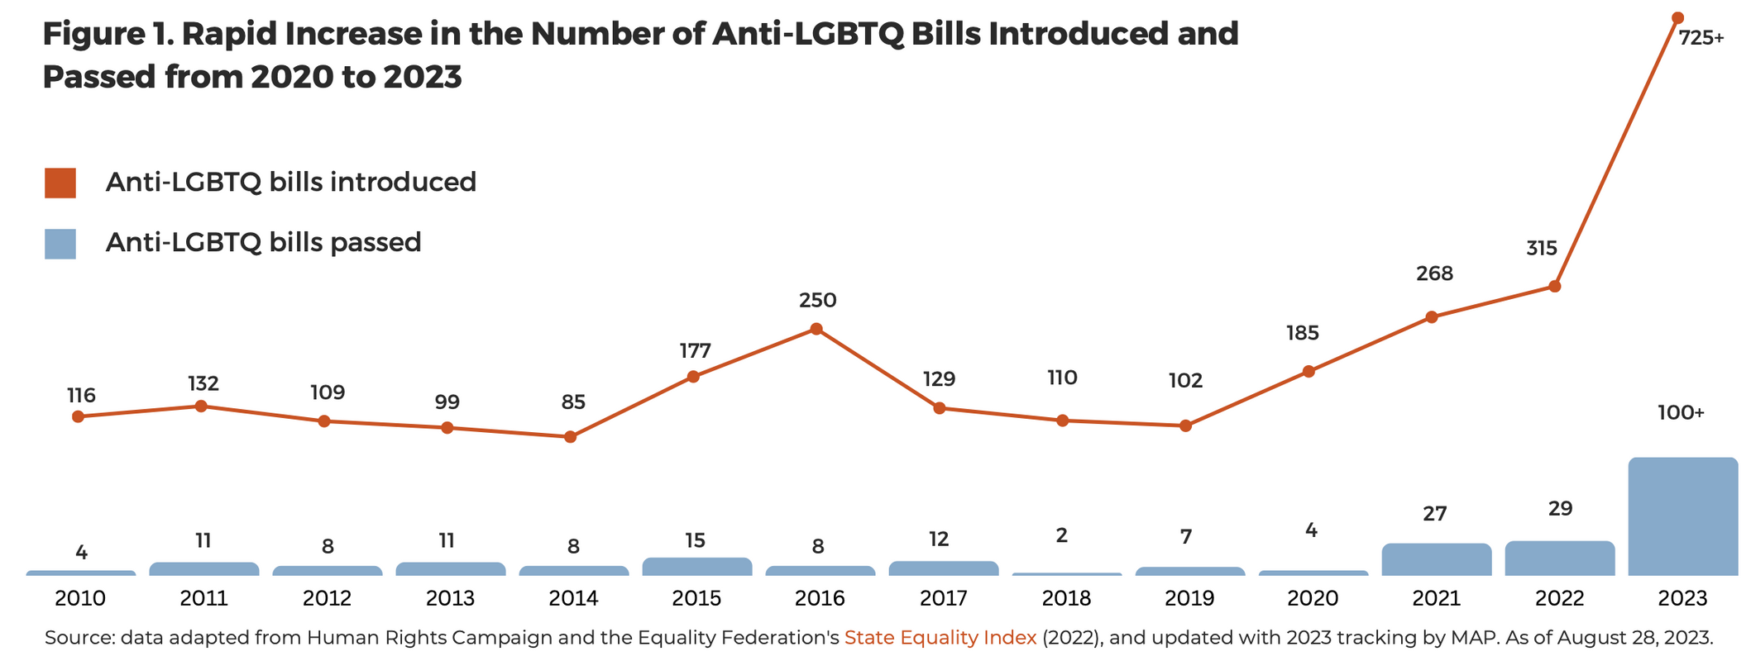
Number of Anti-LGBTQ Bills Introduced and Passed, 2020-2023
‹#›
https://www.mapresearch.org/file/MAP-2023-Under-Fire-Report-5.pdf
Notes:
Alex
We were alarmed when the number of anti-lgbtq bills was approaching 400 and for good reason. But now last year's count surpassed 700. And only 2 and a half months into 2024, we already have hundreds of anti-lgbtq bills introduced. This is without a doubt, the most hostile political environment the LGBTQ+ community has seen in decades.
And unfortunately, they, our opposition, are succeeding.

Slide 5
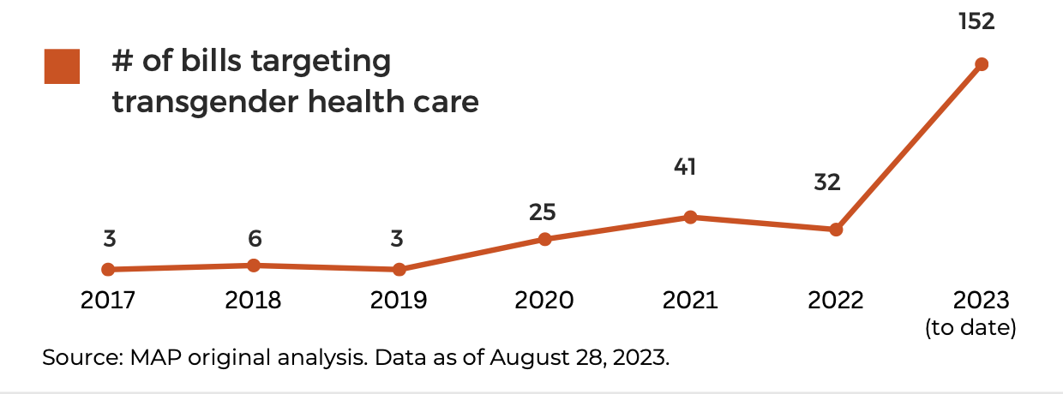
Number of Bills Introduced Targeting Health Care for Transgender People, 2017-2023
‹#›
https://www.mapresearch.org/file/MAP-2023-Under-Fire-Report-5.pdf
Notes:
Alex
You'll hear that a lot throughout this presentation - "our opposition" - we'll dive into who exactly our opposition IS a little bit later, but generally they are an extremely well coordinated, well resourced conservative christian coalition whose agenda of destruction includes overturning Roe V Wade, Dismantling LGBTQ+ rights, and attacking trans people.
Essentially, this is all part of a big push against bodily autonomy
It is a Coordinated effort at command and control of people’s bodies
now to dive into the particular attack on trans healthcare - over to Saea.

Slide 6
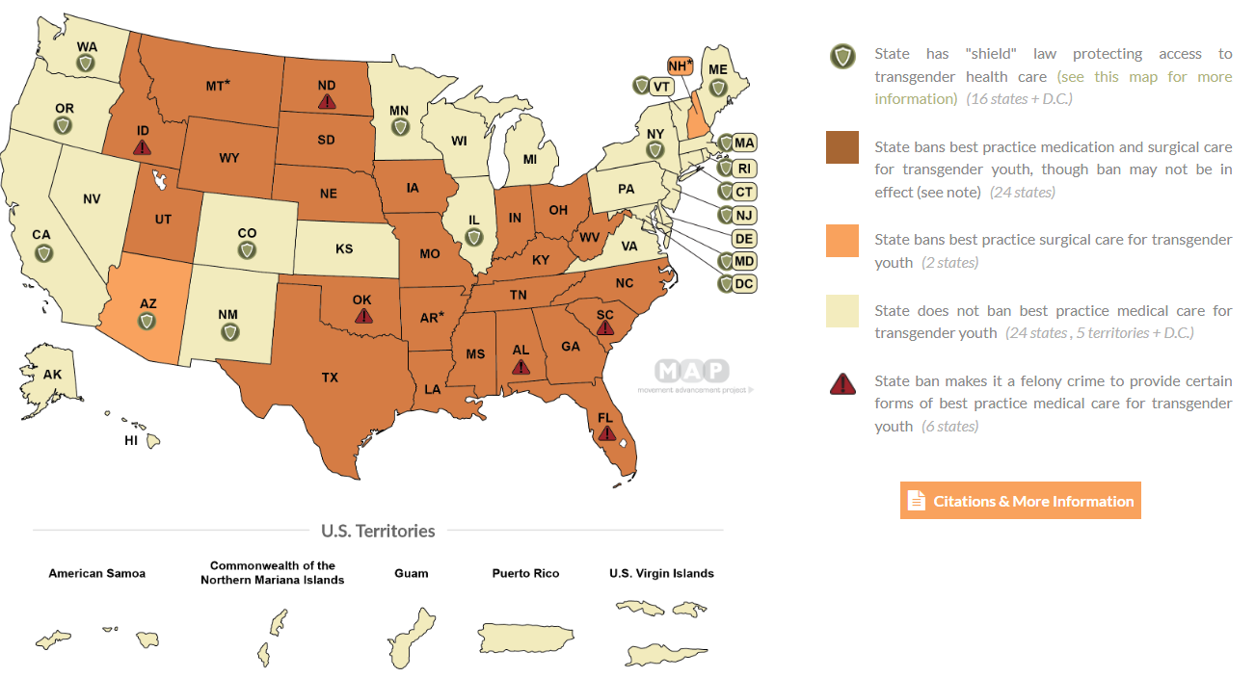
Bans on Transgender Medical Care
‹#›
Notes:
Alex
These bans have passed in 26 states
In this map, you can also see shield states where care is protected - we'll look at those more closely later, but take note of the patchwork of laws across the country. There are clusters of states across the south and midwest that have created a gauntlet of care restrictions.
One important piece to note here: if you were a young person or parent of a young trans person living in Alabama or Mississippi, where would you go. You are essentially caught in a care desert.

Slide 7
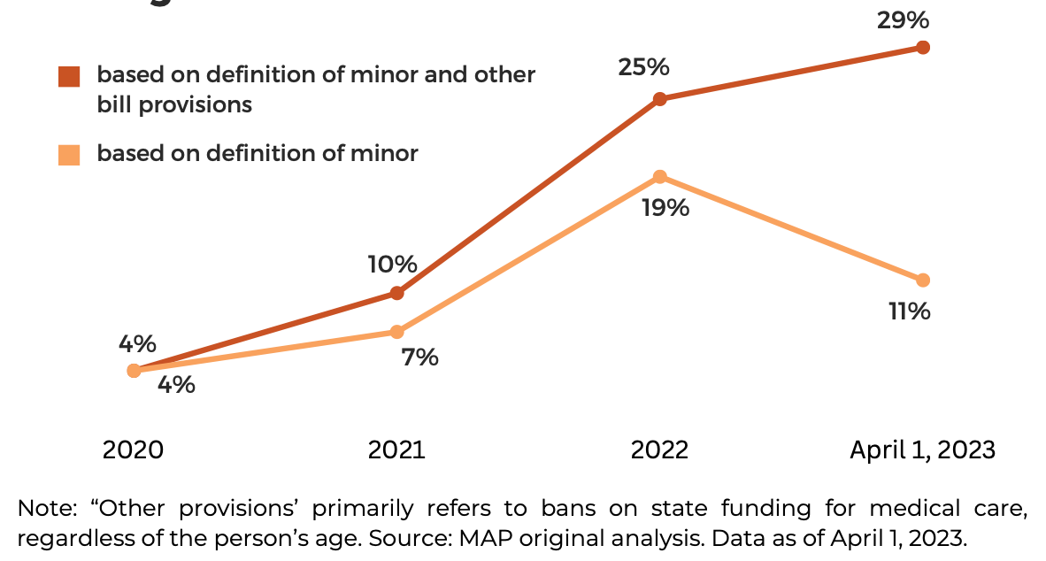
Creeping Towards Adults
‹#›
https://www.mapresearch.org/file/MAP-2023-Under-Fire-Report-5.pdf
Notes:
Sara
Missouri - Medicaid, incarcerated adults
Florida - only MDs allowed to give care, which severely restricted access for both youth and adults because a lot of care is given by NPs for example
Ohio - onerous care requirements whereby needed a care plan approved by an endocrinologist, bioethicist, and mental health professional

Slide 8
What do Transgender Medical Bans Do?
  Prohibit provision of this care (including puberty blockers and hormone therapy)
    Some states prohibit referrals out-of-state for this care
  Penalize medical providers (e.g., loss of licensure)
    Some states have enacted felony charges against providers
  Bans on insurance coverage, including Medicaid
  Bans on state funding for provision of this care
Notes:
Sara

Slide 9
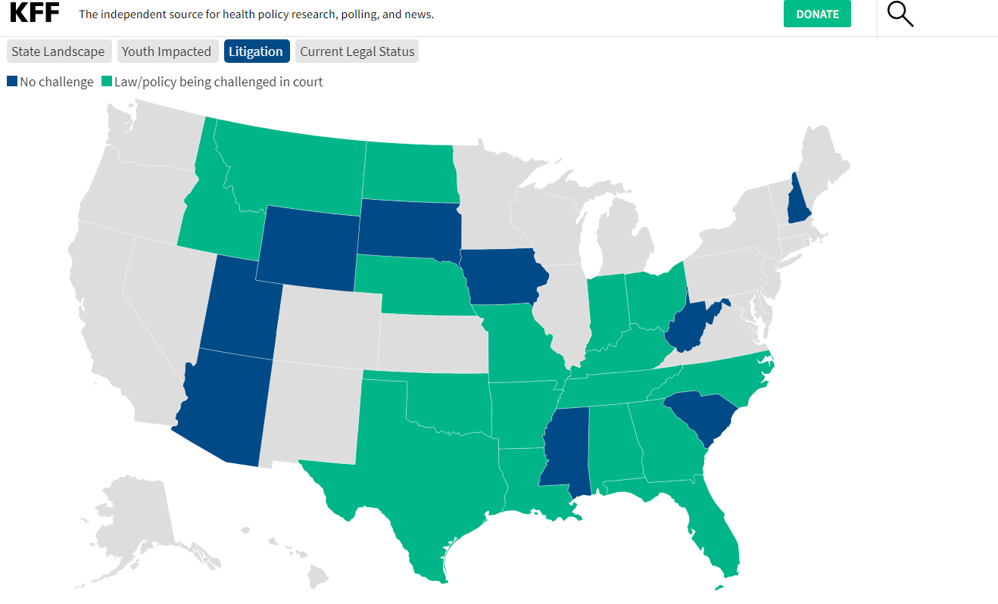

‹#›
Notes:
Sara

Slide 10


‹#›
Notes:
Alex
A little about the strategy behind GLMA as a plaintiff.
And if you haven't been in a courtroom where "experts" explain why your gender identity isn't real - I highly DO NOT recommend it
But litigation is going both ways...
And providers are being sued as well.
there are the providers who have been sued under federal or state law (e.g., Fenway - detransitioner), or had complaints brought against them. Claiming regret.
There is now an entire law firm - called Campbell Miller Payne - created solely for detransitoners to sue providers. If you ever receive communication from Campbell Miller Payne, you can contact US immediately OR go straight to Lambda Legal.

Slide 11
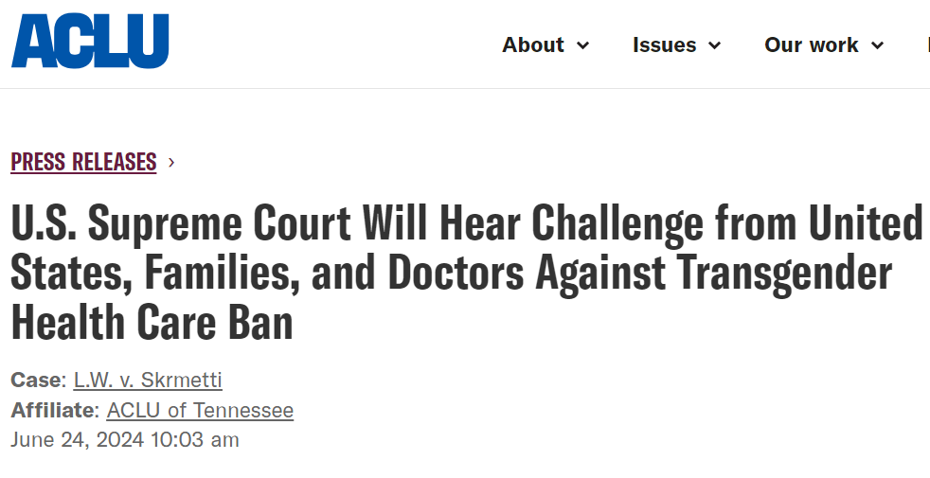

Notes:
Sara
The Supreme Court will hear an unprecedented case regarding Tennessee's ban on gender-affirming care for youth. We expect oral arguments will happen in early December.

Slide 12
Legislative Landscape: Shield Laws
Notes:
Alex

Slide 13
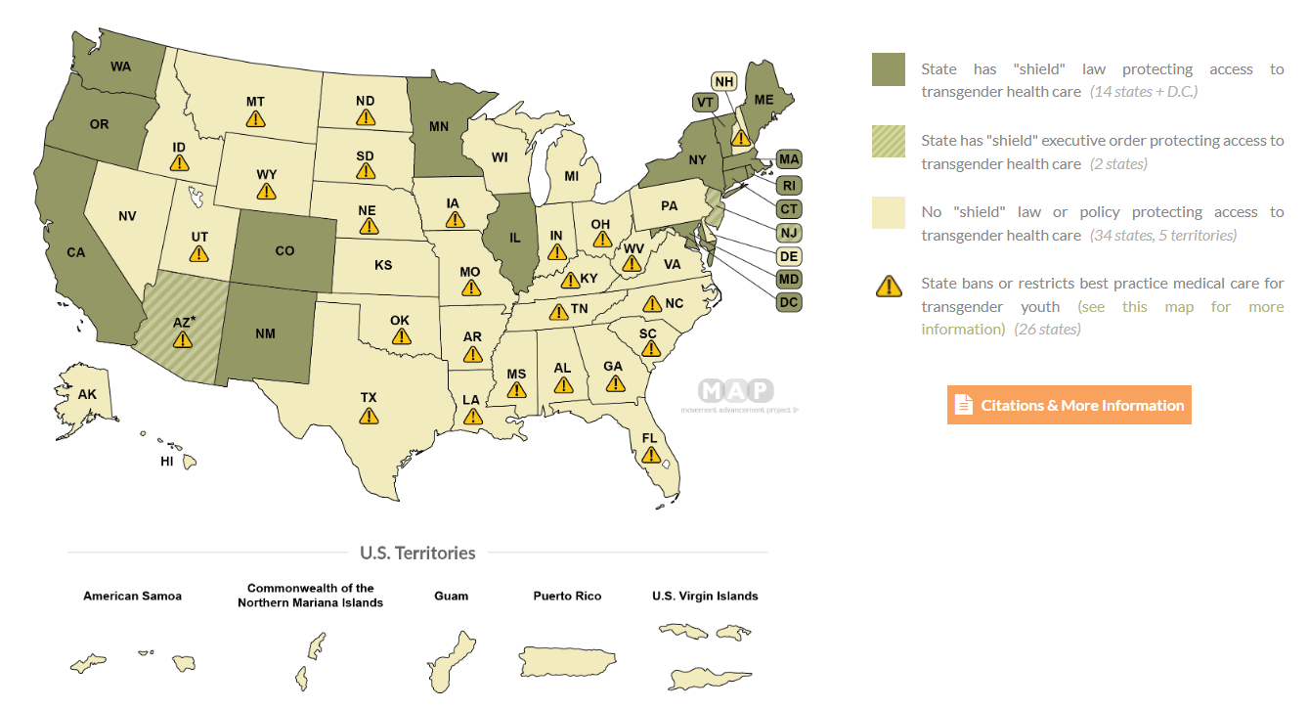
Shield Laws for Transgender Medical Care
‹#›
Notes:
Alex

Slide 14
What do Shield Laws Do?
  Protects individuals who are seeking, providing, receiving, or assisting with lawful healthcare services from investigation and prosecution by out-of-state officials
    Some states also protect against arrests, search warrants, and subpoenas
  Protects gender-affirming care providers from having their license removed or other adverse professional consequences based on providing patients with lawful healthcare in that state
  Protection against disclosure of medical information and/or location data
Notes:
Sara

Slide 15
Why is This Happening?
Notes:
Sara

Slide 16



Disinformation is Running Unchecked
‹#›
Notes:
Sara
Huge disinformation landscape. Mainstream media has framed this care as a debate. We're seeing evidence being distorted about suicidality, regret, and what "low-quality evidence means"
They are uplifting the experiences of a small handful of people who didn't get proper care, and these negative experiences are being used to ban care for everyone.
But we don't see this kind of debate happening for virtually any other area of medicine.

Slide 17
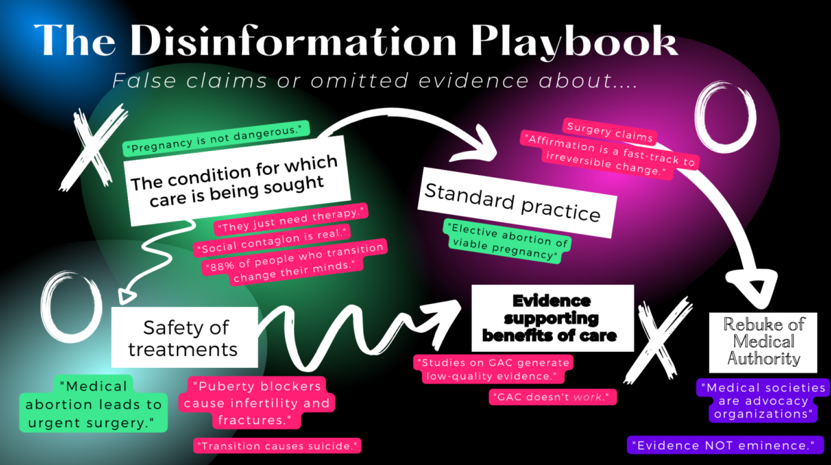
‹#›
Notes:
Sara
This isn’t just about trans care, it’s the same tactics for disinformation that are pushing abortion bans, bans on trans kids in sports. Disinformation, Meredithe

Slide 18
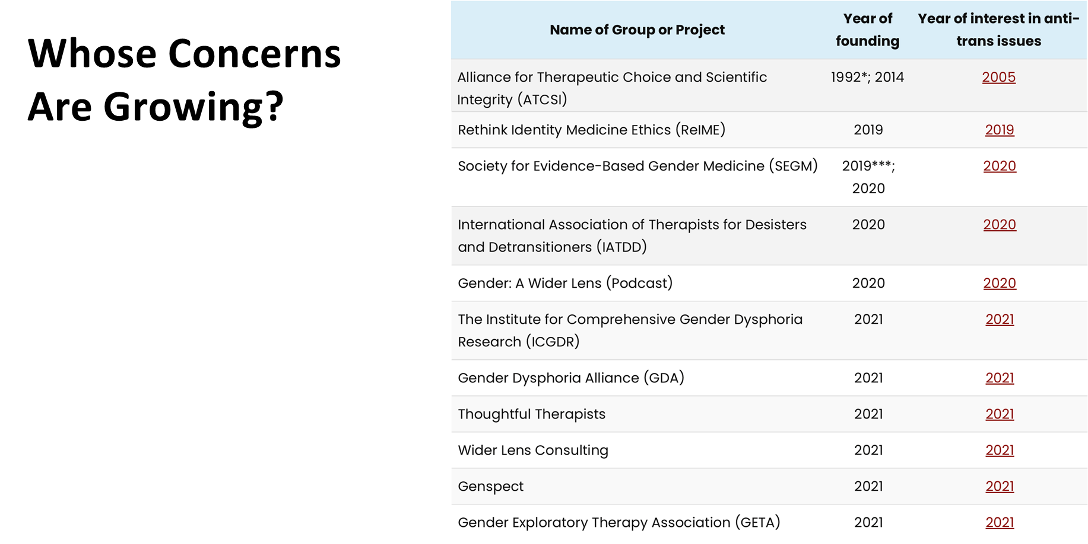
‹#›
Notes:
Sara
Small, coordinated effort by orgs like SEGM and Genspect and Do No Harm that are new, composed of a handful of people, most of whom have never treated or worked with a trans young person.

Slide 19
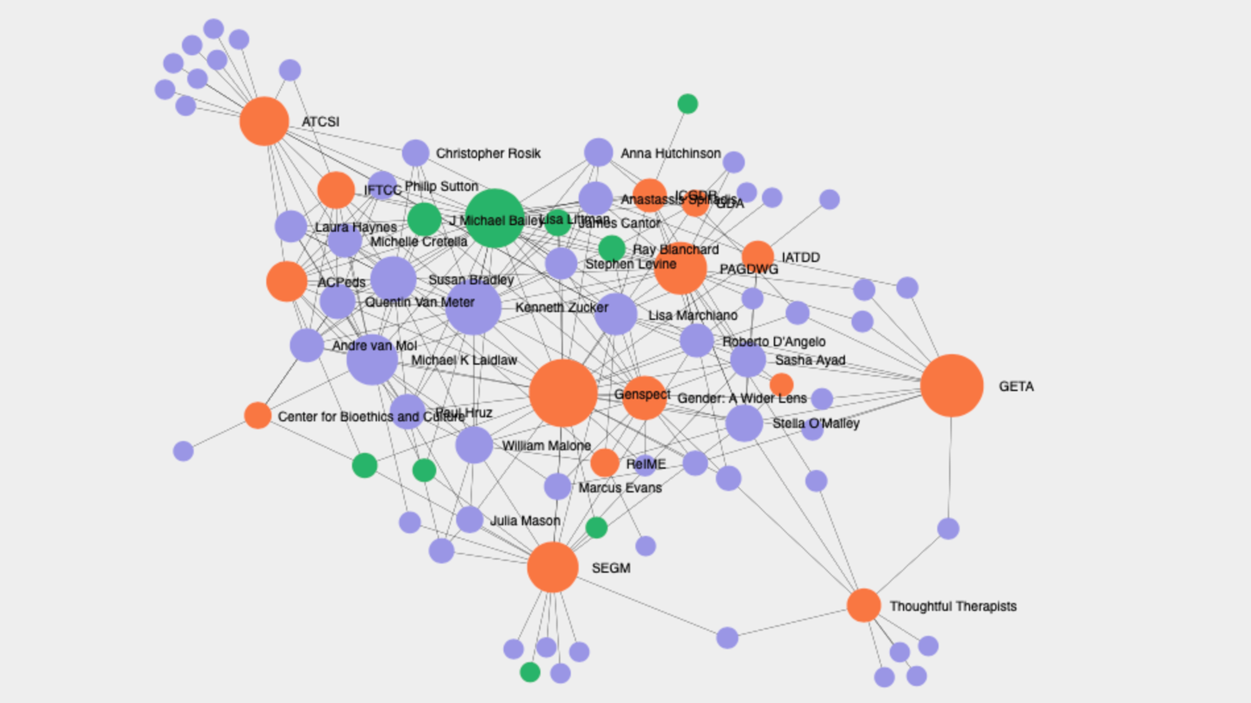

‹#›
Notes:
Sara
Web of actors (Health Liberation Now) - many of these folks are connected, and there is a handful of people who are testifying state-to-state and driving these bans and litigation

Slide 20
The Impact
Notes:
Sara

Slide 21
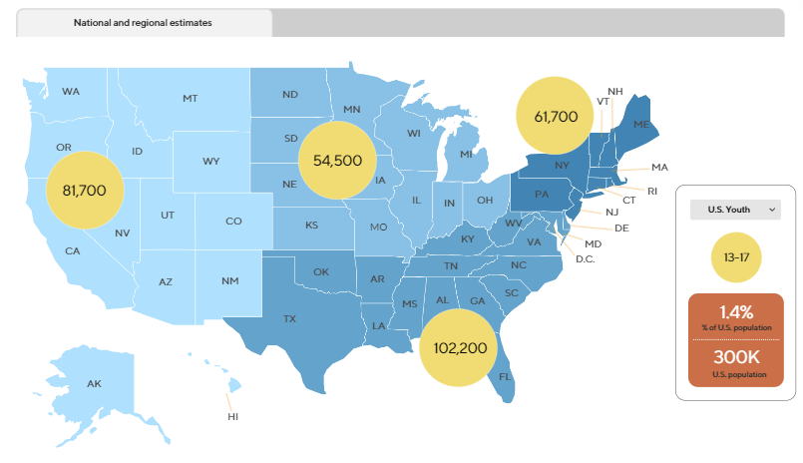
Number of Trans Youth in the US
Notes:
Alex
A reminder that trans youth are everywhere in this country, not just on the coasts

Slide 22
Number of Trans Youth in the US
146,300
Transgender youth have lost or at risk of losing access to medically necessary care
Notes:
Alex
And while we don't have a lot of data on this yet, we know of many families who have relocated entirely because of these bans. This may constitute one of the largest forced migration crises in this country's history.

Slide 23



Impact on the Healthcare System
In a survey of mental health and medical providers across the U.S., 70% shared that either they, their practice, or their institution had received threats specific to delivering gender-affirming care.
(Hughes et al., 2023)
Notes:
Sara
In addition to families, there is a huge impact on the healthcare workforce.
For providers who give this care, we've heard individuals receiving threatening voice mails, being attacked on social media. Institutions like these headlines show have experienced bomb threats.
Consequently, many institutions have scrubbed their pages of their providers or information about care, which makes it even harder for youth and families to access critical health information.

Slide 24
As Laws that Restrict Gender-Affirming Care Take Effect, Overcompliance Leads to Compounding Harms
  Pharmacies are refusing to fill prescriptions, even when they can do so legally.
  Medical providers and institutions that are not covered by the law are denying care.
  Populations that are exempt from the law are experiencing denials of care.
  Providers are terminating care earlier than necessary.
Notes:
Alex
It’s hard to overstate the level of chaos and stress that these cruel bans on life-saving care for transgender youth are causing on the ground. The bans are intentionally vague and their implementation is leading to far-reaching damage.
--In Alabama, where the law (which does not restrict the “dispensing” of medication) is not currently in effect, several pharmacies have told parents that they would no longer fill prescriptions of gender-affirming medication for transgender youth. Similarly, while North Carolina’s law allows trans youth who began a “course of treatment” prior to August 1, 2023 to continue receiving that care in perpetuity, CSE has tracked reports of pharmacies refusing to fill prescriptions for youth who should be able to continue care under the state's grandfather clause.
Medical providers and institutions that are not covered by the law are denying care: In Mississippi, a specific provision forbidding “aiding and abetting” people from helping youth access gender-affirming care (without defining what that means) seems to have had a chilling effect on many different providers, even those who do not offer transgender-related healthcare. This spring, several youth patients reported being turned away from being established at a pediatric office when they were simply seeking treatment for asthma.
Despite grandfather clauses in other states and sunsetting clauses, some states are terminating care right away. For example, Missouri (most notably Washington University in St. Louis), ceased providing gender-affirming care for all youth patients as soon as the law took effect, rather than exempting youth who have already begun a course of treatment.

Slide 25
Effects in “Shield States”
  Providers in states without bans are refusing to provide care to out-of-state patients.
  Providers in states without bans are being inundated with requests for care, causing prohibitively long waitlists.
  Increase in denials, particularly from Medicaid.
  Increased regulation on supportive evidence for claims.
Notes:
Alex
Providers in states without bans are refusing to provide care to out-of-state patients: We have seen several reports of providers in New Mexico and Kansas, where there is no ban on gender-affirming care, cancel or refuse to book appointments with families traveling from states with a ban. Earlier this year Colorado Children’s Hospital announced that it would no longer offer gender-affirming surgery to adults. The hospital had never offered surgery to minors.
And finally, providers in states without bans are being overwhelmed the number of new patient requests. Some clinics have reported waitlists increasing from 2 months to 6 months, from 6 months to one year.
In New York, we've heard of shocking increases in claim denials for HRT. particularly from medicaid. And even with prior authorization in place.
We're going to cover what to do when faced with a denial later.
And in Colorado, we heard from our members who practice behavioral health and regularly provide letters of support for care - that requirements for support letters have changed - one provider showed us a new form from an insurance company in the state - it was 16 pages long. So where he used to write a single page letter of support for each client, he now has to fill out 16 pages of "evidence."

Slide 26
Federal Protections
Notes:
Sara

Slide 27
Section 1557 of the Affordable Care Act (ACA)
Section 1557 is the non-discrimination provision of the Affordable Care Act (ACA).
Under 1557 it is unlawful for healthcare providers and institutions that receive federal funding to discriminate against an individual on the basis of their race, color, national origin, sex, age, or disability. The rule also prohibits discrimination in federally funded health insurance plans.
Sex discrimination includes, but is not limited to, discrimination on the basis of sexual orientation, gender identity, sex characteristics (including intersex traits), pregnancy or related conditions, and sex stereotypes.
Notes:
Sara

Slide 28
HIPAA Privacy Rule
Establishes national standards to protect individuals' medical records and other individually identifiable health information
Under HIPAA, you have rights over your protected health information, including:
  Asking to examine and obtain of a copy of your health records
  Asking to change any wrong information in your file or add information to your file if you think something is missing or incomplete
  Asking that your health information not be shared with certain people, groups, or companies
Know what organizations are legally bound to HIPAA. For example, third party apps are often not covered.
Notes:
Sara

Slide 29
Reporting a Violation of Section 1557 or HIPAA
If you believe that you or someone else has been subject to discrimination in health care or health coverage, you may file a complaint with OCR under Section 1557.
You can also file an OCR complaint if you believe HIPAA has been violated.
Notes:
Sara

Slide 30
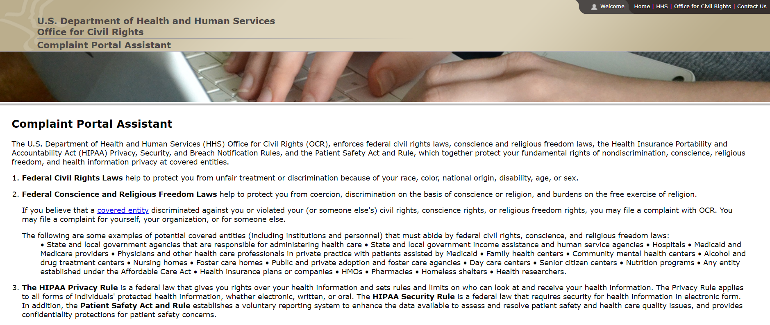
Notes:
Sara

Slide 31
What Can We Do?
Notes:
Alex

Slide 32
What Can We Do?
  Share your story
  Appeal Claim Denials
  Report Harm and Threats
Notes:
Alex

Slide 33
Storytelling is powerful!
  Our stories contribute to the narrative ecosystem
  Emphasize the benefits of this care—and the harms of denying it
  Lead with values
    Privacy of medical decision-making
    Freedom to live as ourselves without government interference
    Love and acceptance for who we are, even with our differences
‹#›
Notes:
Alex
Safety is key - we have resources (or can address in Q&A)
Can help with op-eds, ACLU might be doing something around SCOTUS case

Slide 34
What to do if an insurance claim is denied
First, identify the source of the denial.
  Use ProPublica’s Claim File Helper
  Denials may be sex-specific (e.g., gender marker is not aligned); based on medical necessity (e.g., medical records don’t support necessity of care); or a plan exclusion (either blanket or targeted)
    If the denial is based on the insurance plan terms itself (e.g., the care is outside the scope of coverage), then legal action is usually needed.
    If the denial is based on clinical criteria, there may be more options to submit additional evidence of medical necessity.
Internal appeals process
  This is typically where patients need the most assistance. Provider letters are very helpful and may speak to standards of care, the effects gender dysphoria on the patient, and citing the medical literature.
‹#›
Notes:
Alex
The first step I would recommend is for someone to identify exactly why the claim was denied. That is key to figuring out which next steps are necessary. For example, if the denial is based on the insurance plan terms itself (e.g., the care is outside the scope of coverage), then legal action is usually needed. If the denial is based on clinical criteria, there may be more options to submit additional evidence of medical necessity.
Even if you and/or the patient believe you already know the cause of the denial, this step is crucial for documentation purposes.
You can use ProPublica’s Claim File Helper to find out why the initial claim was denied. A claim file is a collection of the information the insurer used to decide whether it would pay for medical treatment or services. The claim file is often critical information for submitting an effective appeal. (This is a free tool and ProPublica does not store or publish any information without consent.)

Slide 35
What to do if an insurance claim is denied
Administrative support services
  This may look like gender-affirming care navigation services, surgery doulas, or legal aid units at local organizations (e.g., medical-legal partnerships) to help patients navigate this complex process. Often used to help patients get to the external appeal stage.
External appeals process
  This is the “holy grail” for someone facing a medical necessity denial (and is also the hardest one to get). An external appeal is the first time an organization other than the insurance company reviews the denial (e.g., the state or an independently contracted review board). Typically, this is where patients see the most success.
‹#›
Notes:
Alex

Slide 36
Report Harm & Threats
A high priority for the DOJ is investigating and prosecuting hate crimes. Please report any and all threats made against you and your workplaces:
  There are two ways to report a hate crime:
    Contact the FBI online: https://tips.fbi.gov/home
    Contact the DOJ Civil Rights Division online at: https://civilrights.justice.gov
  No matter when the incident occurred, you are encouraged to submit a report. All data collected helps the DOJ identify trends across the country.
‹#›
Notes:
Sara
If you submit something, you likely won't hear anything back. But these types of reports can build a record and show patterns of these threats
Lastly - community care is really important in this moment. There is that level of safety and protection available when we're around people close to us

Slide 37


THANK YOU
Sara Mar, MPH (they/them)
Advocacy & Communications Strategist
smar@whitman-walker.org
Alex Sheldon (they/them)
Executive Director
asheldon@glma.org
Questions?
‹#›

